Slide 1
Clustering and K-Means

Slide 2
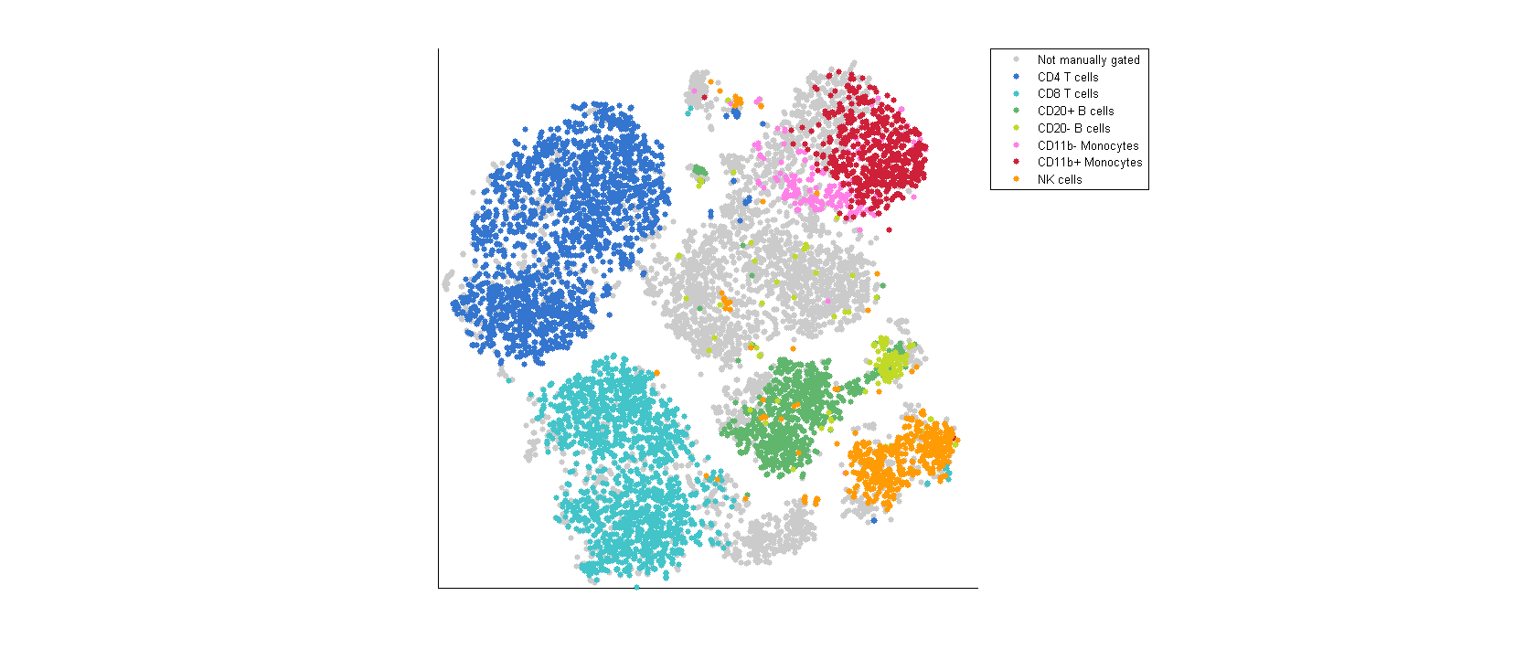
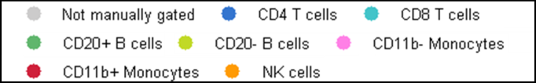
tSNE Map of Immune Cells
van der Maaten JMLR 2008, 2014
Amir et al. Nat. Biotech 2013
Notes:
This is what we would want to see.
Cell types are well separated
We can see additional structure that is missed by the manual gating

Slide 3
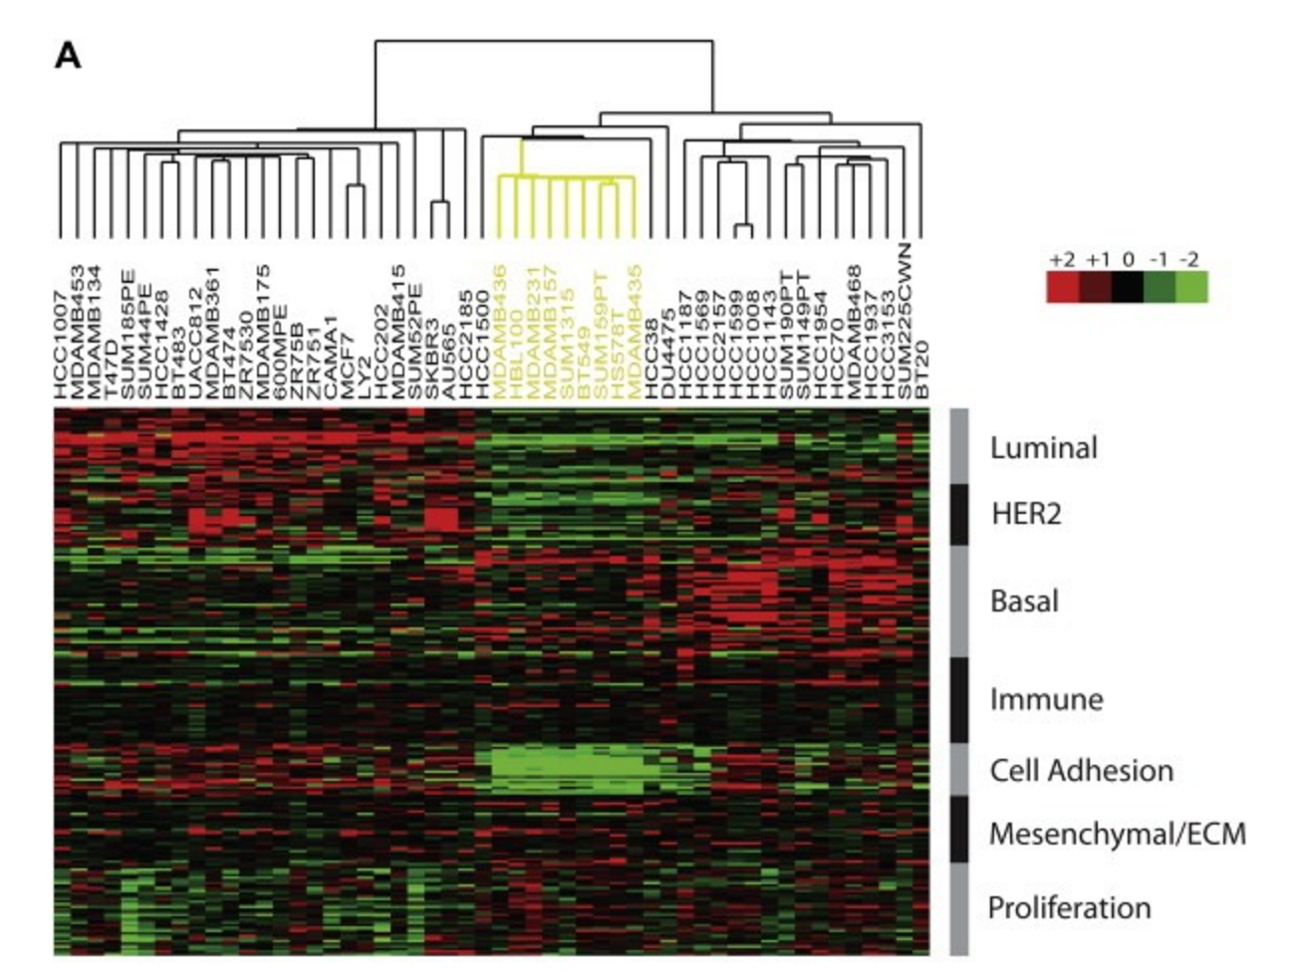
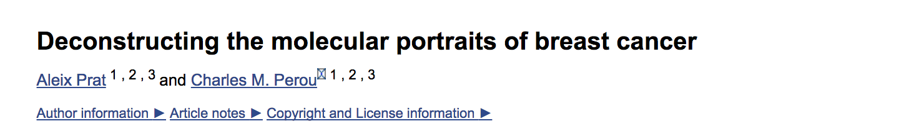
Breast Cancer Subtypes

Slide 4
What is clustering?

Slide 5
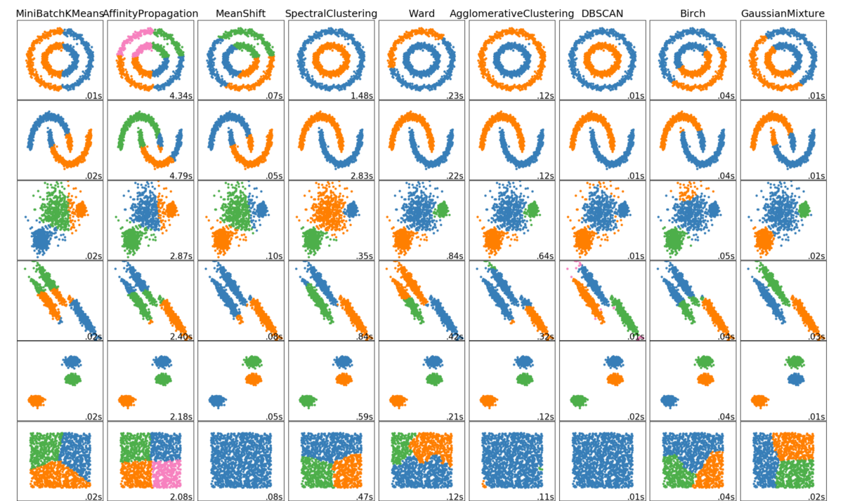
Clustering Methods

Slide 6
Explore how other methods work
https://towardsdatascience.com/the-5-clustering-algorithms-data-scientists-need-to-know-a36d136ef68
Choose a method in python
Try it on the same datasets

Slide 7
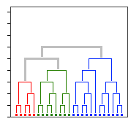
Grouping of Similar Objects
Linkage Clustering, Community detection

Slide 8
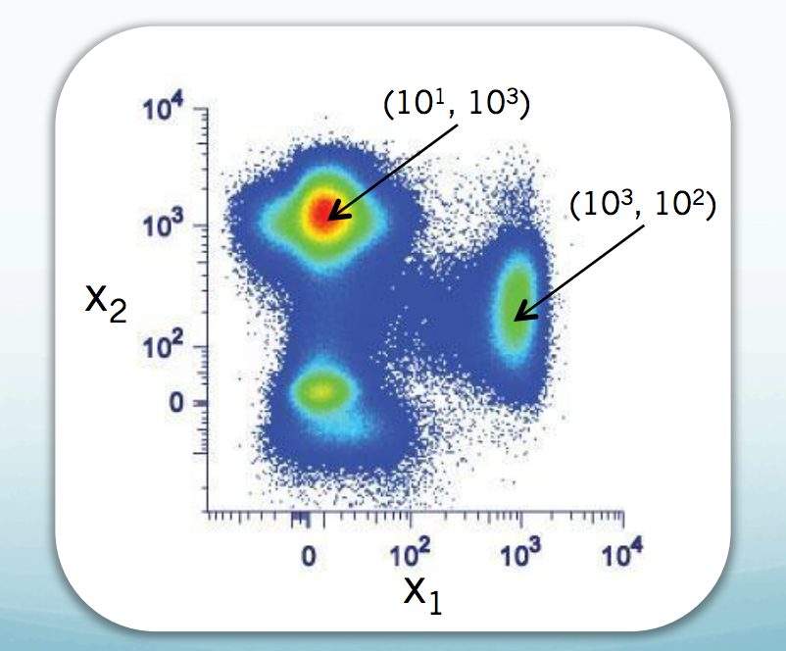
Density Centers
DBSCAN, Gaussian Mixture Model

Slide 9
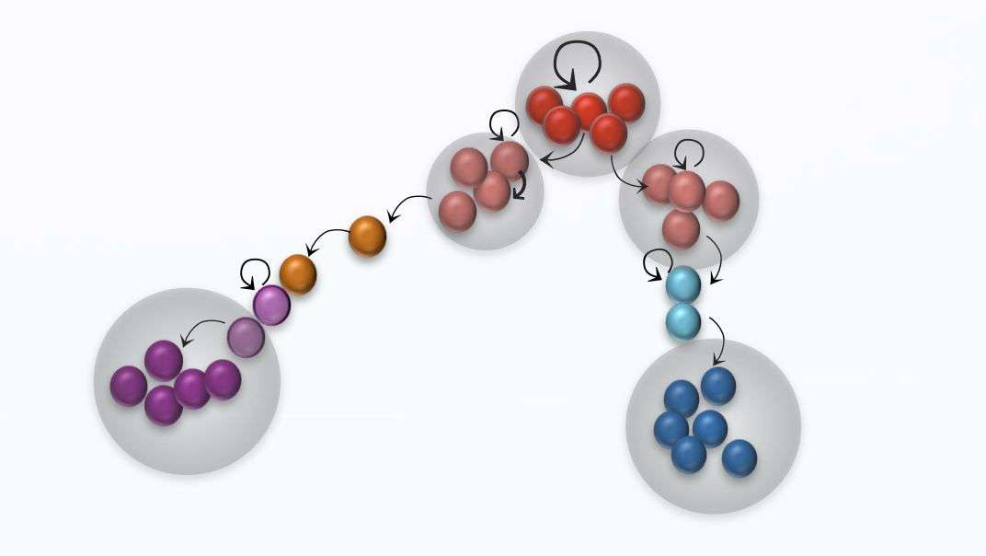
Metastable States in A Manifold
PHENOGRAPH

Slide 10
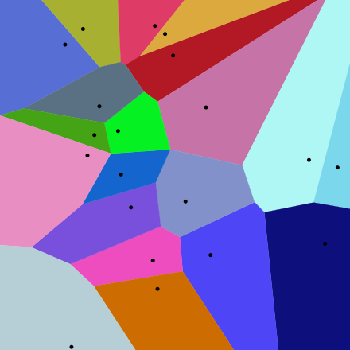
A partitioning of the data space
Voronoi Diagram
K-MEANS (Macloed 1967), Fidduccia Matheyses

Slide 11
How is the partition picked?
By minimizing different objective criteria
Closeness of members within the group
Distance/Separation between groups
Ratio of the two
Minimum cut of an NN-graph
Other criteria?
Modularity: actual edges/ expected edges

Slide 12
k-means clustering

Slide 13
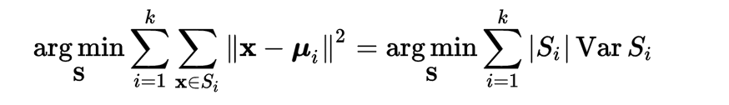
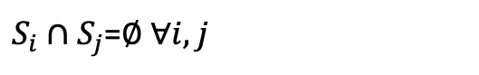
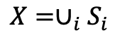
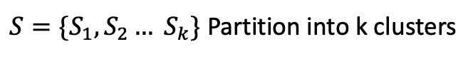
K-Means Optimization: Mean Squared Error
Given datapoints:
Find: the within-cluster variance is minimized
Subjec to:
$S=\{S_{1}, S_{2}… S_{k}\}$ Partition into k clusters
$$X=∪_{i}S_{i}$$
$S_{i}∩S_{j}$=$∅ ∀i,j$

Slide 14
K-Means Clustering Algorithm
Initialization: Pick K random cluster centroids
Assignment step: Assign each datapoint x_{i} to cluster S_{j} that has the nearest mean u_{j}
Update step: Compute the means of clusters
Nearest mean minimizes squared Euclidean distance

Slide 15
Yes: K-means Converges
Will this process stop?
Why?
Each reassignment step LOWERS mean squared error
Update of means lowers variance
Therefore this optimization goes to a local minima

Slide 16
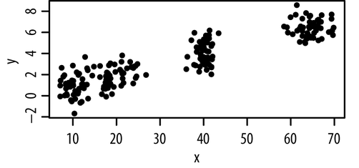
k-Means minimizes within-cluster sum-of-squares
Unlabelled data

Slide 17
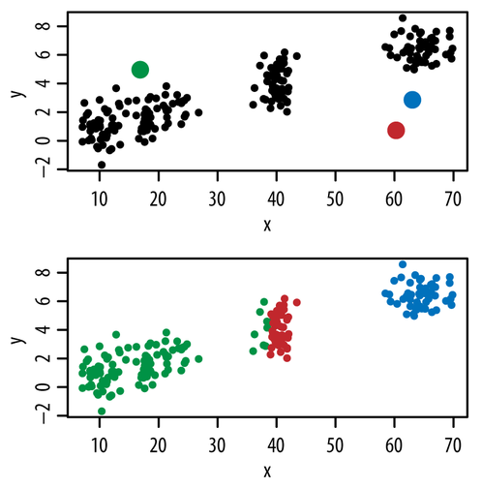
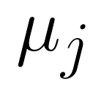
k-Means minimizes within-cluster sum-of-squares
centroid
Random initialization
Assign points to nearest centroid

Slide 18
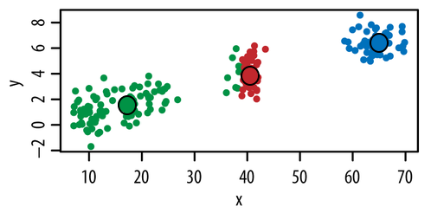
k-Means minimizes within-cluster sum-of-squares
Repeat until convergence
Assign points to nearest centroid
Move centroids to middle of cluster
2.
3.

Slide 19
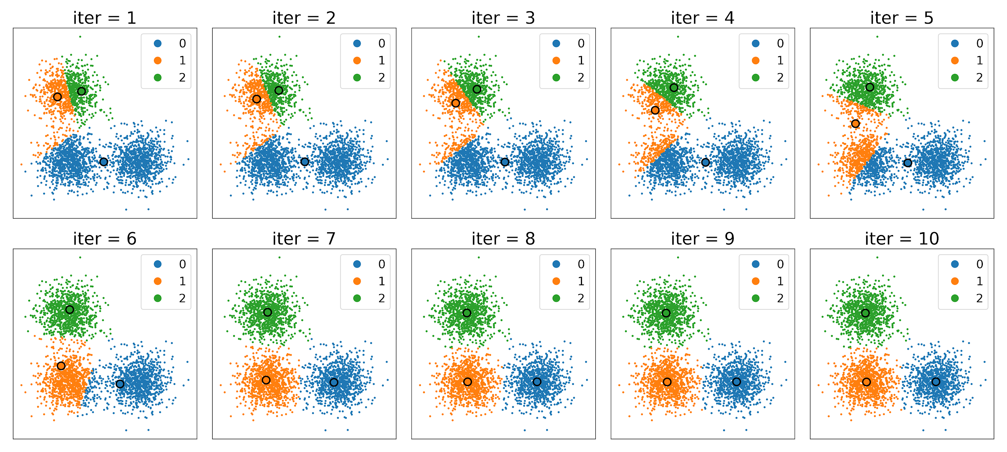
10 iterations of KMeans on Gaussians

Slide 20
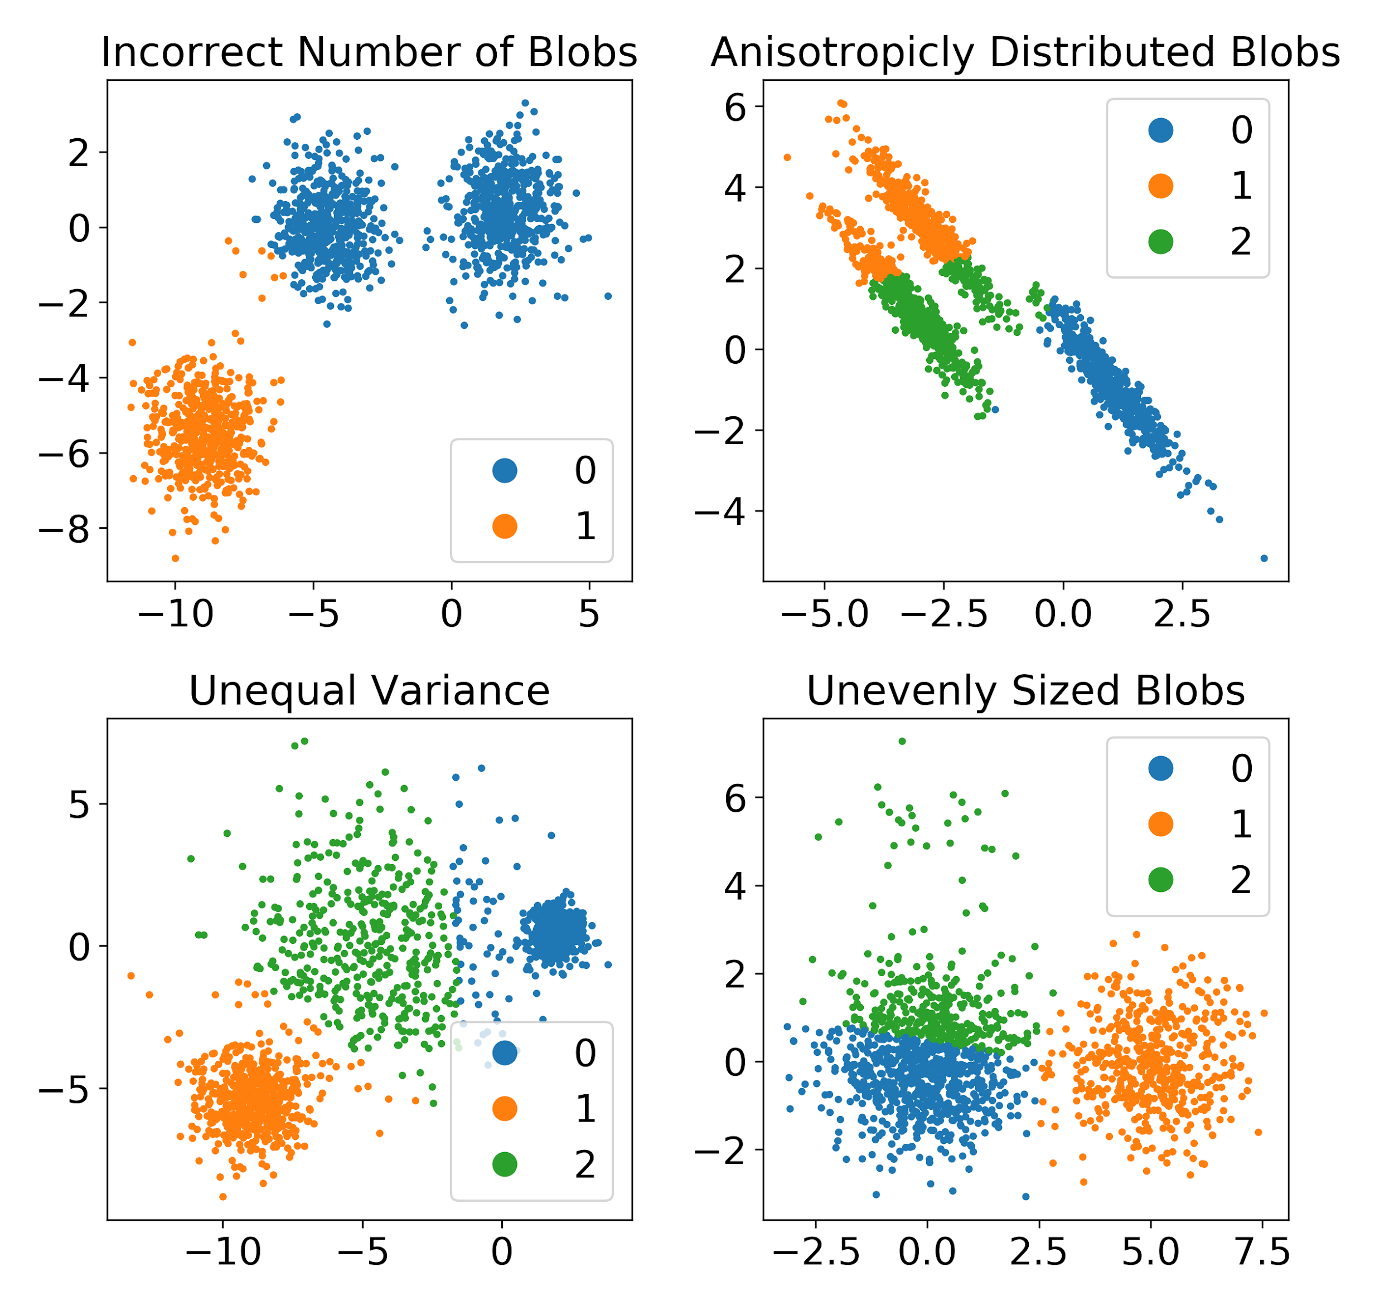
“K-means clustering is not a free lunch”
k-Means assumes:
K is chosen correctly
The data is distributed normally around the mean
All clusters have equal variance
All clusters have the same number of points
K-Means is sensitive to:
Initialization
Outliers
http://varianceexplained.org/r/kmeans-free-lunch/ https://scikit-learn.org/stable/auto_examples/cluster/plot_kmeans_assumptions.html

